Slide 1
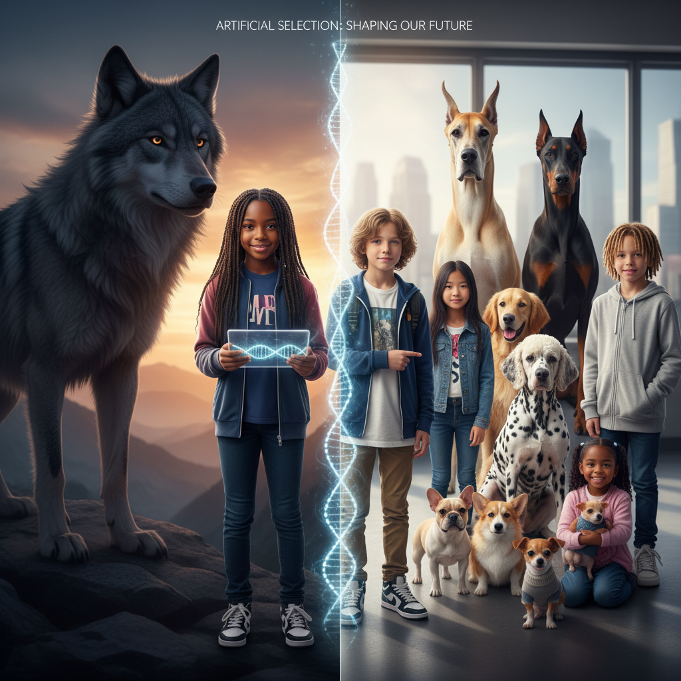
ModelIt!
Student Lesson
We Built a Better Dog (And Maybe a Mistake)
How Humans Hack Evolution Through Selective Breeding
NGSS: MS-LS4-5
7th Grade
1/9

Slide 2
What You Will Learn Today
Learning Goals
* Explain how artificial selection differs from natural selection
* Model how selection pressure affects trait frequency over generations
* Predict unintended consequences of extreme selective breeding
* Evaluate ethical implications of genetic modification technologies
Key Vocabulary
Selective Breeding
The process of choosing organisms with desired traits to reproduce, gradually changing the population over generations
Artificial Selection
Human-directed evolution — choosing which organisms reproduce based on traits we want, rather than natural survival
Genetic Variation
The differences in DNA between individuals in a population — raw material for selection
Trait Frequency
How common a specific trait is in a population — selective breeding changes this over generations
2/9

Slide 3
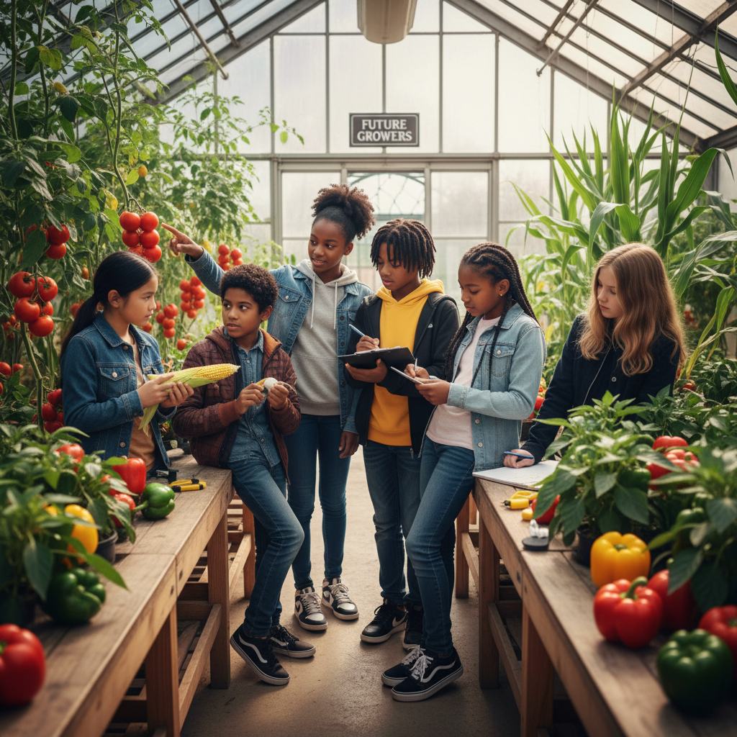
The Big Question
How have humans changed plants and animals to suit our needs — and at what cost?
How Humans Hack Evolution Through Selective Breeding. Today we'll build a MODEL to discover the answer!
3/9

Slide 4

Today We Will Build a Model!
A model helps us understand complex systems!
1. LOCATE
Identify the COMPONENTS (parts) of the system
2. ESTABLISH
Connect them with RELATIONSHIPS (+ or -)
3. VISUALIZE
Build your model in ModelIt!
4. EVALUATE
Run SIMULATIONS to test scenarios
5. REVISE
Improve your model based on evidence
4/9

Slide 5

Activity 1: Sort the Components
Sort these components into EXTERNAL (inputs from outside) and INTERNAL (inside the system):
Your Components:
* Selection Pressure
* Generation Time
* Desired Trait Frequency
* Genetic Diversity
Think: Which components can we control? Which happen on their own?
5/9

Slide 6
Activity 2: Connect with Arrows
Draw arrows to show HOW components affect each other:
(+) POSITIVE Relationship
When one goes UP, the other goes UP too
(-) NEGATIVE Relationship
When one goes UP, the other goes DOWN
Think About It:
When selection pressure is extreme (like breeding only the flattest-faced bulldogs), desired trait frequency goes up — but what happens to genetic diversity? Is there a hidden cost?
6/9

Slide 7
Activity 3: Run the Simulation!
Test these scenarios in ModelIt!
Mild Selection
Set Selection Pressure to low and observe gradual changes over many generations
Extreme Purebred Selection
Lock Selection Pressure to maximum and observe both trait frequency AND genetic diversity
No Selection (Wild)
Set Selection Pressure to zero and observe what natural variation looks like
Watch the activity graphs change!
[ModelIt Platform Screenshot - Simulation Results Graph]
7/9

Slide 8
What Did We Discover?
Our Model Showed Us:
* Artificial selection works the same as natural selection, but humans choose the 'fittest' traits instead of nature
* Extreme selection increases desired traits but DECREASES genetic diversity — making populations vulnerable
* Many purebred dogs suffer health problems directly caused by selective breeding for appearance
* All domestic dogs evolved from wolves through thousands of years of human-directed selection
Answer: Humans change organisms through selective breeding — choosing individuals with desired traits to reproduce generation after generation. It works, but there's a hidden cost: extreme selection reduces genetic diversity, making populations vulnerable to disease and creating health problems. Purebred bulldogs can barely breathe because we bred them for flat faces!
8/9

Slide 9
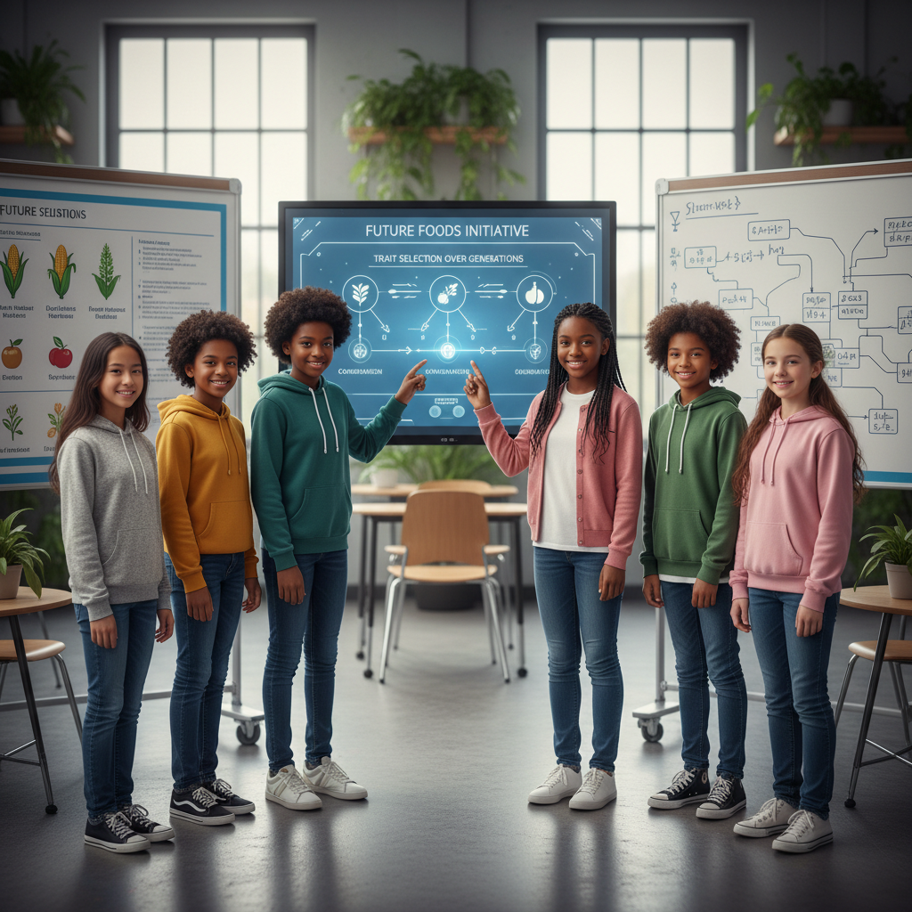
STEM Challenge: Design a Responsible Breeding Program
YOUR ENGINEERING MISSION
Design an ethical, evidence-based crop improvement program that increases yield while maintaining genetic diversity, using your understanding of artificial selection.
The Challenge:
A farming community is losing crop harvests to a new pest. They need your team to design a selective breeding program that develops pest-resistant crops WITHOUT sacrificing genetic diversity.
Think Like an Engineer:
* How can you select for pest resistance without reducing genetic diversity too much?
* What's the difference between selective breeding and genetic modification (GMO)?
* What safeguards should be in place to prevent unintended consequences?
REAL CAREER CONNECTION: Geneticists and Agricultural Scientists develop improved crop varieties and animal breeds using selective breeding and biotechnology. They work for universities, USDA, and biotech companies, earning $65,000–$120,000/year. The skills you're using TODAY are the same ones they use on the job!
9/9

